Slide 1

PLD, Your One Stop Lock
Why worry? When you can just
pop-it. Lock-it. and Drop-it.

Slide 2

HOW secure are your belongings?
Questions one might ask
How simply can I become a victim of theft?
Do I need to protect anyone from any of my personal assets?
Is my home actually safe?
I just don't have the time to check...

Slide 3

What is PLD One Stop Lock?
A simplistic, modular, and smart security system
For those with or without technology backgrounds
Designed for consumers with multiple practical uses
Provides a layer of security, at an affordable cost
Made possible through micro computers, various sensors,
and other off the shelf parts
What can be done with PLD One Stop Lock?
Universal lock, can be added wherever you feel like it could be utilized
Control the device(s) via your smart phone or tablet
Hidden keyless entry for redundancy

Slide 4
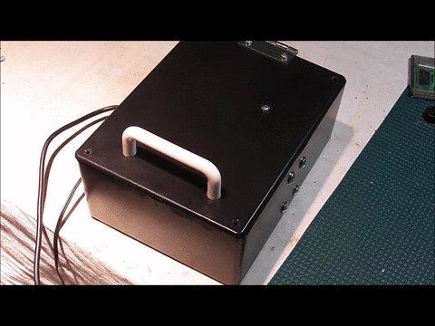
How do I use it?
Pop-It.
Whenever you need it unlocked, it’s a simple push
of a button or tap of a magnet
Lock-It.
Once device is closed or shut it will remain shut
until opened again
Drop-It.
Drop your worries!

Slide 5



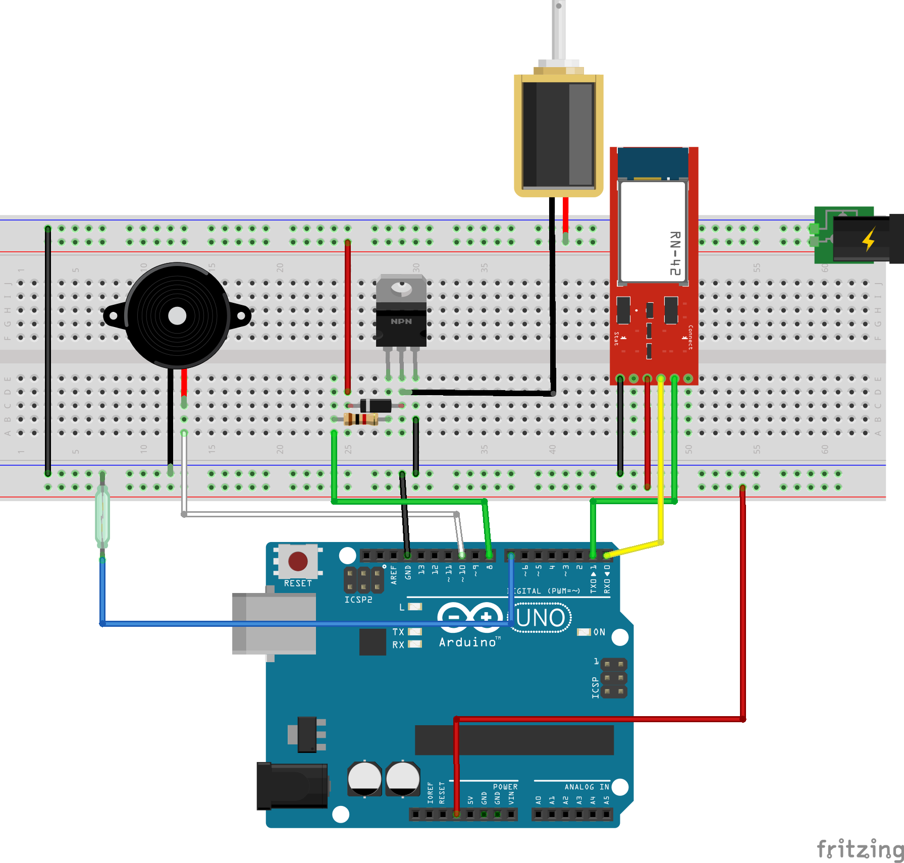
How does it really work?
Centralized Arduino Uno - Connected to...
Solenoid Locks
Used to unlock the device upon command
Input Device (Bluetooth Device or Magnetic Reed Switch)
Paired Bluetooth device sends signal
Open/close based on magnetic field
Output device (Piezo Speaker, Cell Phone)
Audible notification that the device is unlocked
Bluetooth application displays locking status

Slide 6

AND REMEMBER IT’s AS SIMPLE AS…
Thanks for Listening!

